Slide 1

WEATHER APPLICATION USING – OPEN WEATHER API
TEAM-2

Slide 2

TEAM MEMBERS :
20071A12C5- B.JEEVIKA
21071A12C6- B. SANDHYA
20071A12C7- B.KARTHIK
20071A12C8 – B.SAHITHI

Slide 3

CONTENTS :
INTRODUCTION
STEPS FOR IMPLEMENTATION
RESULTS
CONCLUSION

Slide 4

INTRODUCTION :
We Create a Weather App Using HTML, CSS, and JavaScript Codes. In this Weather app we will get weather information from weather API and deploy it on the network we will be using open weather map API so we will be using this API specifically one called API for this project so this project will be completely responsive site.

Slide 5
STEP 1: Set up your development environment
Create a new project folder and set up the basic structure of your web app. Install the necessary tools and software, such as a code editor. and a web server.

Slide 6
Step 2: Connect to the API
Use the Fetch API or an HTTP client library like Axios to make a request to the Open Weather Map API using your API key. Use the API response to extract the relevant weather data, such as temperature, humidity, and wind speed

Slide 7
Step 3: Display the weather data
HTML, CSS, and JavaScript to display the weather data on your web app. Use CSS to style your app and make it look visually appealing and user-friendly.

Slide 8
Step 4: Add interactivity
Add interactivity to your weather app, such as a search bar to look up weather data for different locations, or a feature to save favorite locations.Add interactive elements like buttons or sliders to allow users to customize the display of weather data.

Slide 9
Step 5: Make your app
Step 5: Make your app responsive Use CSS media queries to make your weather app responsive and adapt to different screen sizes and devices.

Slide 10
Step 6: Test and deploy
Test your weather app thoroughly to ensure that it is functional and free of bugs. Deploy your app to a web server or hosting service so that it can be accessed by users.

Slide 11
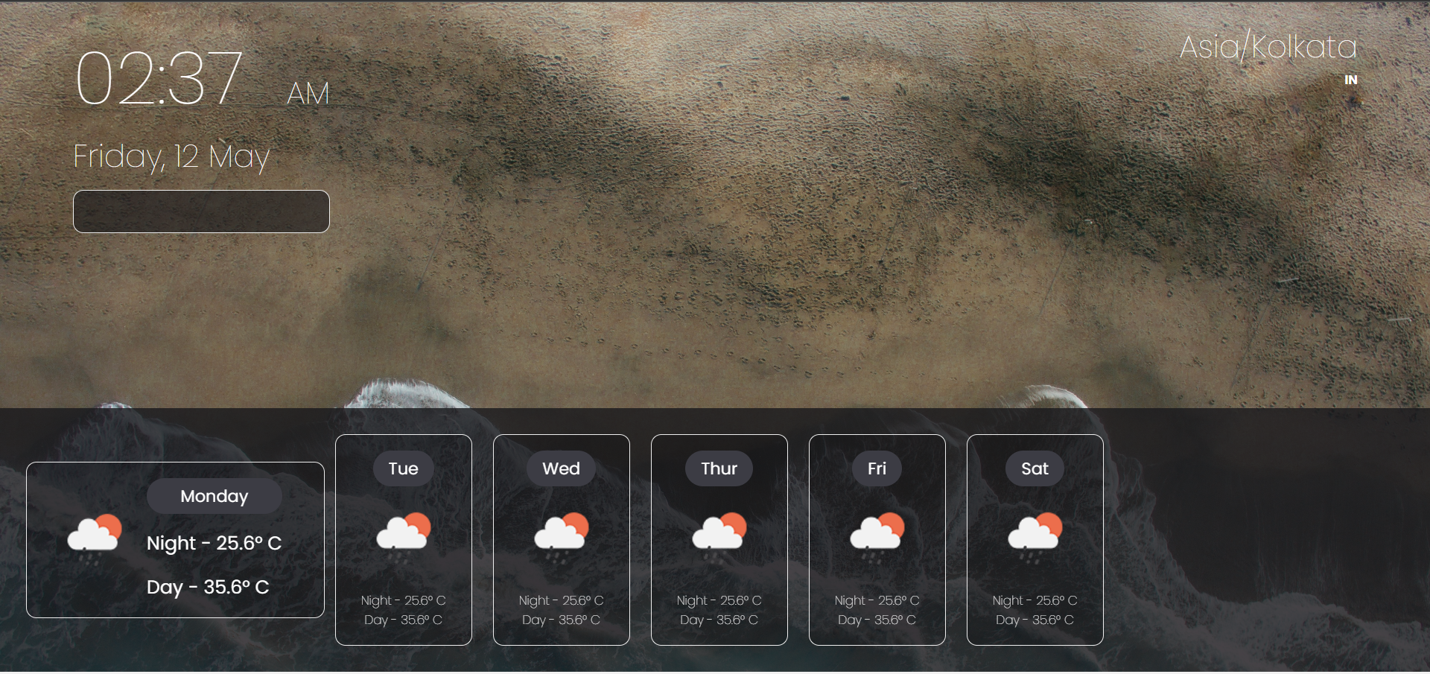
IMPLEMENTATION

Slide 12
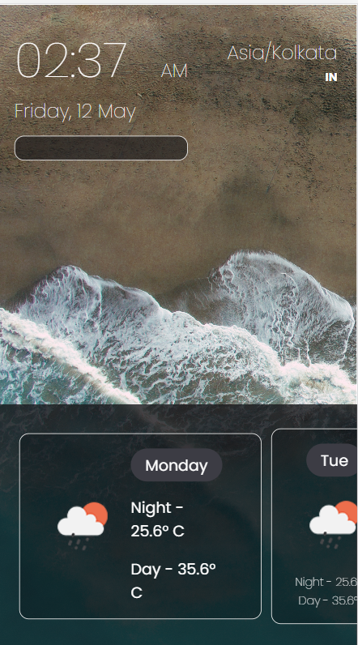
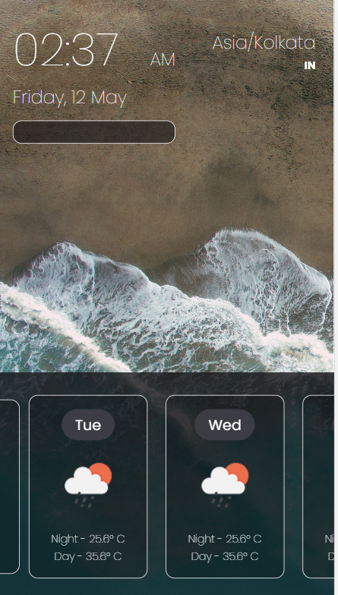

Slide 13
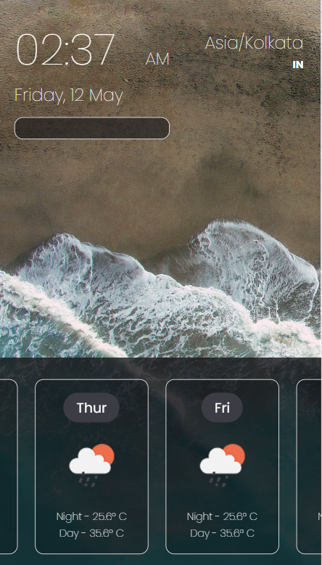
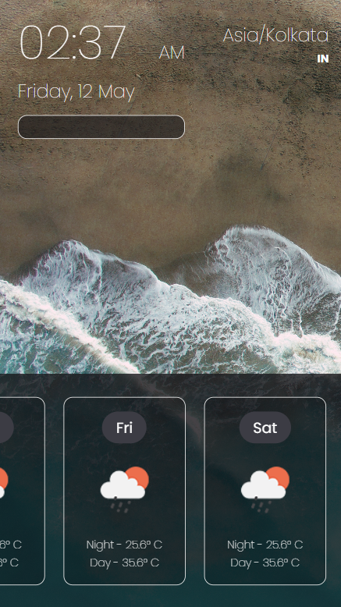

Slide 14
CONCLUSION
In conclusion, weather app is a web-based application that facilitates and allows users to check the weather updates. This innovation has revolutionized the way people do . eliminating the need for physical effort and saving time. For their Work. Weather app is a prime example of the potential of technology to enhance our lives and streamline our daily tasks.

Slide 15


